Slide 1
Personal Exemptions
Pub 17 – Chapter 3
Pub 4012 – Tab C
(1040-lines 6a & 42)
NJ 1040
Notes:
1

Slide 2
Exemption
Defined: Specific amount of money you are allowed to deduct from your taxable income, based on circumstances of your filing situation
Two types of Exemptions:
Personal Exemption
Dependent Exemption (to be covered in another section)
Update all exemption-related data on TW Main Information screen.
Data is carried to Federal 1040 Page 1 and NJ 1040 Page 2

Slide 3
Personal Exemptions Types
Exemption Type | Federal Exemption | NJ Exemption
Personal exemption for Taxpayer & Spouse | Yes | Yes
Domestic Partner | No | Yes (only if partner doesn’t file own NJ1040)
Blind | No (added to standard deduction) | Yes (either for Blind or Disabled)
Disabled | No | Yes (either for Blind or Disabled)
Minor can claim self | No | Yes
Age over 65 | No (added to standard deduction) | Yes
NJ generally follows Federal rules for personal exemptions, with a few additions

Slide 4
Personal Exemption Rules Taxpayer and Spouse
One exemption for taxpayer (and one for spouse when MFJ)
Taxpayer (or spouse) is ineligible for exemption if another can claim them
Widow(er), if not remarried by 12/31, can claim spouse in year of death, i.e. - MFJ
MFS can claim spouse –
if spouse has no gross income, spouse not filing a return, & spouse not the dependent of another taxpayer
Notes:
4

Slide 5
NJ Exemption: Domestic Partner
NJ 1040 Page 3
Although not recognized on Federal 1040, Domestic Partners who are dependents are entitled to a NJ 1040 exemption only if partner does not file a NJ tax return
Domestic Partner is different than Civil Union Partner
Specific rules apply. Refer to experienced counselor
Notes:
Eligibility for Domestic Partnership, both partners must qualify:
Share a common residence
Jointly responsible for each other’s welfare
Both are 62 years of age or older
Neither person is in a marriage, domestic partnership, or civil union recognized by New Jersey law
Has not terminated another domestic partnership in prior 180 days
Not legally related to each other by blood, adoption, or marriage closer than the fourth degree (They cannot be third cousins or closer)
Jointly responsible for each other’s basic living expenses during the domestic partnership
Benefits:
Can claim the other partner as a dependent on his or her New Jersey state tax return. (Note: This is not true for the purposes of federal tax returns)
Group health insurance coverage for state employees is extended to domestic partners and the children of domestic partners
If a domestic partner dies without a will, the domestic partner has the same rights of inheritance that a spouse has under the law
Possible risks:
Could impact ability to get certain types of financial aid where eligibility is determined based on income of family unit
Additional Exemption ($1000)

Slide 6
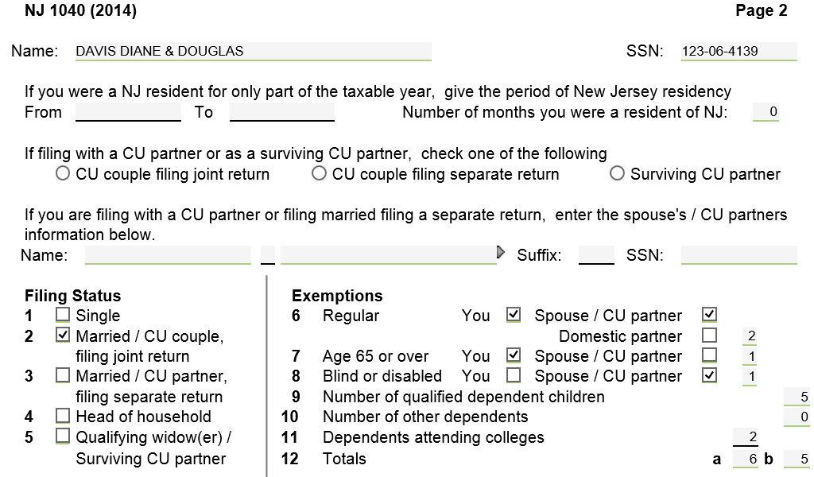
TW NJ 1040 Page 2 Domestic Partner

Slide 7
TW No Extra Exemption For 65 or Over but Addition to Standard Deduction-Federal 1040

Slide 8
TW Extra Standard Exemption For 65 or Over - NJ 1040

Slide 9
Who is Considered Disabled for Federal Tax Purposes?
For Federal tax purposes a person is considered disabled if at any time during the tax year he/she:
Could not engage in substantial gainful activity for pay or profit due to a physical or mental condition AND
A doctor has determined that this condition has lasted or can be expected to last continuously for at least a year or can be expected to lead to death
Additional standard deduction allowed on Federal 1040 for blind only (not other disabilities)
Disabled persons may be eligible for other Federal tax benefits like credits (covered in later modules)
Notes:
Anyone who is receiving SS disability (therefore recorded as disabled) by SS is by default considered disabled

Slide 10
Who is Considered Disabled for NJ Tax Purposes?
For NJ tax purposes: a person is considered disabled if on the last day of the tax year he/she:
Could not engage in substantial gainful activity for pay or profit due to physical or mental impairment, including blindness
Reporting: Must enclose a copy of the doctor’s certificate or other medical records with NJ tax return the first time the exemption is claimed
Additional exemption allowed on NJ 1040 for blind or disabled
Disabled/Blind persons may be eligible for other NJ tax benefits like property tax relief programs (covered in later module)
Must file a paper return accompanying doctor’s certificate in the first year the taxpayer is disabled

Slide 11
Who is Considered Blind for Federal and State Tax Purposes?
For Federal and State tax purposes a person is considered Blind if on the last day of the year they are totally blind or
A taxpayer who is not totally blind must have a certified statement from an eye doctor (ophthalmologist or optometrist) that:
The taxpayer cannot see better than 20/200 in the better eye with glasses or contact lenses, or
The field of vision is not more than 20 degrees
Additional standard deduction allowed on Federal 1040 for blind
Additional exemption allowed on NJ 1040 for blind

Slide 12
TW Identification of Blind, Disabled – Main Info Screen
Notes:
Indicate that taxpayer is disabled on Main Info screen under Taxpayer Information section

Slide 13
TW No Extra Standard Deduction for Disabled, Only Blind – Federal 1040
Notes:
No extra standard deduction for disabled on Federal return (only blind)

Slide 14
TW Extra Exemption for Blind or Disabled – NJ 1040
Notes:
Can claim extra exemption for blind or disabled on NJ 1040 Line 8
Federal claims 7 exemptions
Taxpayer and spouse
5 children (including grandson)
Also gets extra standard deduction for taxpayer being over 65, but no extra for disabled
NJ claims 11 exemptions
Taxpayer & spouse
Both taxpayer & spouse over 65
Spouse is disabled
5 children (including grandson)
2 full-time college students

Slide 15
Federal/State Differences: Exemptions for Minors Claimed on Parent’s Return
ITEM | FEDERAL | STATE | COUNSELOR ACTION
Minor/ Claimed on parents’ return | Minor cannot claim personal exemption for self | Minor can claim personal exemption for self | Check Box 6A on Main Info Screen – “You can be claimed on another person’s return”
Notes:
Note: For Federal return, even if Parent did not claim minor, but could have…student can’t claim self on Federal

Slide 16
Minor Claimed on Parent’s Return – Main Info Screen Minor’s Federal 1040

Slide 17
Minor Claimed on Parent’s Return – Minor’s Federal 1040
Can’t take exemption for self since minor was claimed on parents’ Federal return
Notes:
Since minor was claimed on parents’ Federal return, cannot claim exemption for self on minor’s Federal return

Slide 18
Minor Claimed on Parent’s Return – Minor’s NJ 1040
On NJ 1040, OK to take exemption for self even when minor was claimed on parents’ Federal return
Notes:
Minor can still claim exemption for self on minor’s NJ return, even if parents claimed him
TaxWise does this automatically
Minor’s return not shown in TaxWise

